Slide 1

Alternate EVV Vendor Town Hall

Slide 2
Welcome and Town Hall Guidelines
The focus of this town hall is to review the necessary steps and share essential information for alternate Electronic Visit Verification (EVV) vendors to exchange production data with the CalEVV Aggregator successfully.
During the town hall, all participants have been placed on mute.
Post presentation-specific questions using the Q/A feature. Sandata will moderate the Q/A and answer questions during the presentation, time permitting.
Technical questions not answered during the presentation will be answered after the town hall.
We will be sending a survey after the town hall, and we welcome and encourage feedback.

Slide 3
Agenda
Discussion Topics Presented by Sandata
Welcome and Town Hall Guidelines
California Status and Process Overview
EVV Vendor Specification and JSON
Configuration for California
Common Alternate EVV Vendor Support Issues
Integration Best Practices
Alternate EVV Vendor and Provider Agency Support Resources

Slide 4
CalEVV Status and Process Overview

Slide 5
CalEVV Provider Self-Registration Process
Provider Agencies
Existing Provider Agencies have no actions to complete.
New Provider Agencies must register as a PCS and/or HHCS provider in the Self-Registration portal.
Once in the portal, New Provider Agencies will indicate whether they are planning to use the CalEVV system or an Alt EVV, (third-party), system.
Based upon the selection of an Alt EVV system by the New Provider Agency in the portal, Sandata will confirm the provider’s selection to both the provider and their selected Alt EVV system vendor.
This will initiate the Alt EVV Certification process for new Alt EVV system vendors.

Slide 6
CalEVV Provider Self-Registration Process Continued
New Provider Agencies
Provider Agencies will complete the CalEVV Self-Registration through the portal. Registration Includes
Platform indicator of CalEVV or Alternate EVV System vendor+ contact information
Provider billing identifiers (NPI, DDS Vendor ID, etc.)
Provider Agency Contact information
Confirmation of receipt is provided by Sandata via email
Sandata reviews registration responses
The Next Call to Action for the provider agency will be aggregator training for those using an alternate EVV system vendor.

Slide 7
Alternate EVV Vendor Testing & Certification
New Alternate EVV Vendors
Receive testing credentials and testing certification checklist from Sandata.
The checklist will guide through what must be included in the files and uploaded during testing.
Testing can begin upon receipt of the information.
If testing is unsuccessful, Sandata will return the checklist marked with erroneous files/scenarios to the Alternate EVV vendor.
Tests can be resubmitted until all errors have been corrected.
Upon completion of the testing checklist, the Alternate EVV vendor should email Sandata at CAAltEVV@sandata.com to request the testing validation.
Existing Alternate EVV Vendors
There is no certification required and the testing environment can be utilized for any updates.

Slide 8
Alternate EVV Vendor Testing & Certification Continued
Certification
New Alternate EVV Vendor Completes testing - Positive and Negative
Sending of client (member) data
Sending of employee (caregiver) data
Sending of visit data
Return completed testing checklist to Sandata
Sandata reviews and approves checklist

Slide 9
Process Overview
Credentials
Each new provider agency completes CalEVV training.
Sandata provides new provider agency production credentials to share with their Alternate EVV Vendor.
CalEVV Go-Live
Alternate EVV Vendor begins sending visit data for new provider agencies who have received production credentials.

Slide 10
EVV Vendor Specification

Slide 11
Understanding the Alt EVV Vendor Specification
The Alternate EVV Vendor specification and user guide are linked from the CalEVV website.
Alternate EVV Vendor specification: https://sandata.zendesk.com/hc/en-us/articles/4410089222547-California-CalEVV-EVV-Vendor-Solutions-Specifications-v1-3
Specification user guide: https://sandata.zendesk.com/hc/en-us/articles/4410278275987-California-CalEVV-Specification-User-Guide
The Alternate EVV Vendor specification contains three sections
Client
Employee
Visit
Notes:
Both documents are also available in an accessible format

Slide 12
Client Overview
Four segments for client records
Client General - Required
Client Address - Required
Client Payer - Required
Client Phone - Recommended
Identifiers are used for matching logic
ProviderID value: 6 -10 Digit User ID provided during the self registration.
ClientIdentifier: 8 Digit + 1 Alpha (A-Z) Client Identification Number (CIN) or 7 Digit Universal Client Identifier (UCI).
This value is expected to be sent for the client in all Visit records.
A second identifier for clients can be associated with the Client record.
Notes:
Provider IDS from provider

Slide 13
Client Overview
Client Validation
Client General (parent) segment is required
ClientIdentifier length
ClientAddress segment is required
ClientPayer segment is required
ClientPhone segment is recommended
Notes:
Provider IDS from provider

Slide 14
Client Payer Child Segment
Six required elements for ClientPayer.
PayerID - California Waiver program in Appendix 1
PayerProgram - “PCS” for 1/1/2022 in Appendix 1
JurisdictionID - Jurisdictional Entity ID in Appendix 4
Regional Center
MSSP Site
MCWP Waiver Agency
Waiver Agency
MCPs
County

Slide 15
Client Payer Child Segment Continued
(Continued)
ProcedureCode– HCPCS in Appendix 2
Client Status – Active or Inactive
Effective Start Date – Date service is valid for Client
ClientPayer child segment is required to be sent for each authorized service that is being rendered to the client.

Slide 16
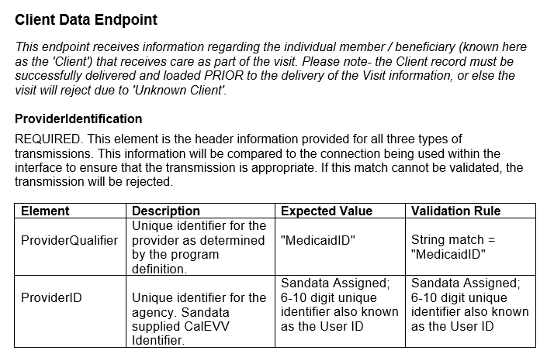
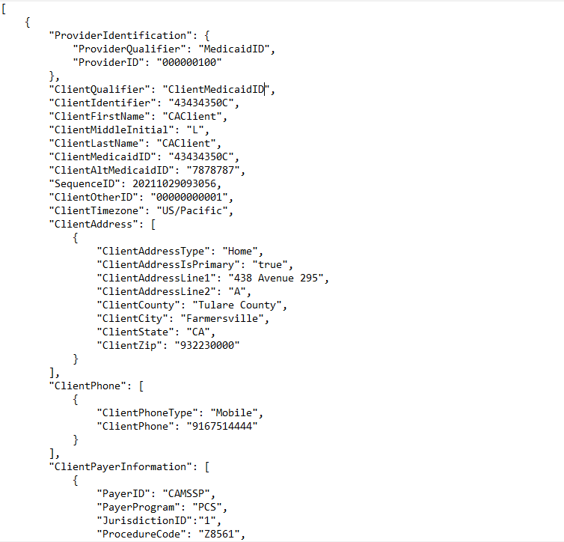
Client Overview: JSON
EVV vendor data is sent via RESTful API / JSON transmissions
Notes:
Helpful Talking Point: Provider "Medicaid ID" for DDS is the provider's vendor ID from their regional center.

Slide 17
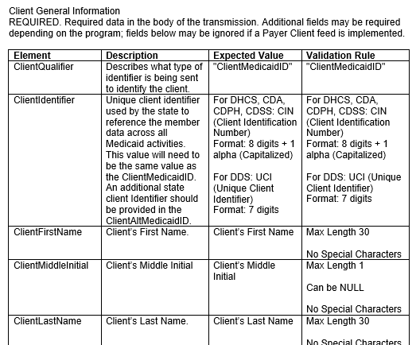
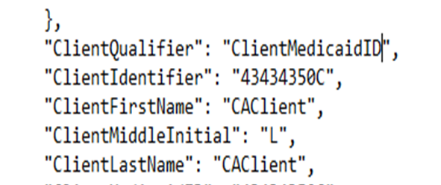
Client Overview: JSON

Slide 18
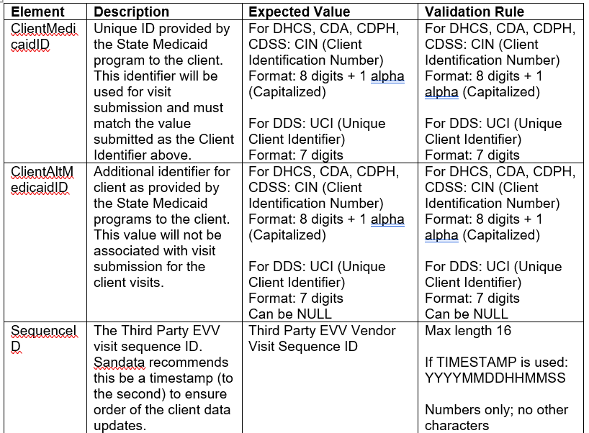
Client Overview: JSON

Slide 19
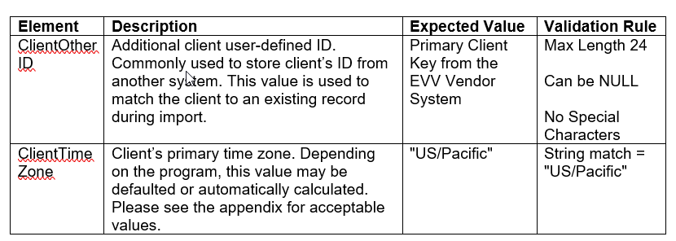
Client Overview: JSON

Slide 20
Employee Overview (Caregiver/Staff)
One required segment for Employee (Caregiver/Staff):
Employee General
Identifiers used for matching logic:
ProviderID value: 6-10 Digit User ID provided during self-registration
EmployeeIdentifier: Provider’s 1-9 Digit Unique Identifier for Employee
This value is expected to be sent for the Employee in all Visit record
Do not use Employee SSN full or partial as this identifier.
Employee Validation
EmployeeIdentifier length check
EmployeeIdentifier will be matched to existing records:
No Match = Insert new record
Yes Match = Update existing

Slide 21
Visit Overview
One required segment for Visit Records:
Visit General
Two conditional segments for Visit Records
Call
Visit Changes

Slide 22
Visit Overview Continued
Identifiers used for matching logic
ProviderID value: 6-10 Digit User ID provided during self-registration
VisitOtherID value: ID from Alternate EVV Vendor system
ClientIdentifier: 8 Digit + 1 Alpha Client Identification Number (CIN) or 7 Digit Universal Client Identifier (UCI)
EmployeeIdentifier: Provider’s 1-9 Digit Unique Identifier

Slide 23

Visit Overview Continued
Procedure code validation
PayerID, PayerProgram, & ProcedureCode must match to a valid record as listed in the specification.
ClientIdentifier must match to existing client record
Error Message: “Client_ID Not Found” will post if a Client record has not been successfully processed.
EmployeeIdentifier must match to existing employee record.
Optional segments are required based on the condition for the segment.
Example: When a change is required for a visit previously sent to the CalEVV, the updated visit will require the VisitChange Segment.

Slide 24
Visit Overview Continued
The Alternate EVV system is expected to be able to handle a visit that crosses calendar days for a maximum of 24 hours.
AdjInDateTime and AdjOutDateTime elements
only be sent with a value if the time provided in the Call segment is adjusted
include a change log and reason code for the adjustment.
Changes and Acknowledgements
Send change log and reason codes for adjustments or acknowledgements on the initial transmission of a visit.
Send change log and reason codes for changes on a subsequent transmission of a visit.
Send a change log and reason code for all acknowledgements of non-fixable exceptions.

Slide 25
Services and Modifiers
Appendix 2: Services + Modifiers
Payer | Program | HCPCS Code | Modifier 1 | Modifier 2 | Modifier 3 | Modifier 4 | Service Description
CACCS | HHCS | G0156 |  |  |  |  | CCS -Hhcp-svs of aide,ea 15 min
CACCS | HHCS | G0162 |  |  |  |  | CCS - Hhc lpn/rn obs/asses ea 15 min
*CACCS | HHCS | S9123 |  |  |  |  | CCS - INP - RN nursing/ per hour
*CACCS | HHCS | S9124 |  |  |  |  | CCS - INP - LPN/LVN/ per hour
*CACCS | HHCS | T1030 |  |  |  |  | CCS - INP - RN shared nursing
*CACCS | HHCS | T1031 |  |  |  |  | CCS - INP - LPN/LVN shared nursing
CACCS | HHCS | G0299 |  |  |  |  | CCS - Hhs/hospice of rn ea 15 min
CACCS | HHCS | G0300 |  |  |  |  | CCS - Hhs/hospice of lpn ea 15 min
CACCS | HHCS | T1002 |  |  |  |  | CCS - Rn services up to 15 min
CADDS | PCS | Z9027 |  |  |  |  | RC Homemaker 858
CADDS | PCS | Z9028 |  |  |  |  | RC Homemaker Service 860
CADDS | PCS | Z9029 |  |  |  |  | RC In-Home Respite Service Agency 862
CADDS | PCS | Z9030 |  |  |  |  | RC In-Home Respite Worker 864
*Services annotated with an asterisk (*) will be ready for visit transmission starting 10/5/22.

Slide 26
Visit Exceptions
Exceptions ensure data aligns to program definition for the CalEVV program.
CalEVV exceptions will cause incomplete visit status; and therefore, are not acknowledgeable via the API.
For errors, correct the missing or incorrect data and resubmit the transaction.
Exception Code | Exception Name
0 | Unknown Clients
1 | Unknown Employees
2 | Visits Without Any Calls
3 | Visits Without In-Calls
4 | Visits Without Out-Calls
23 | Missing Service
34 | Unauthorized Service Exception

Slide 27
Configuration for CalEVV
Appendix 4: Jurisdictional Entities
Jurisdictional Entities will include Regional Centers, MSSP Sites, MCWP Waiver Agencies, MCPs, Counties, etc. that contract directly with the provider agencies on behalf of the State department waiver programs.
The Jurisdictional Entities ID will be provided in the JurisdictionID element of the ClientPayer segment in the Client record. Please refer to the full list in the Specification Appendix 4.
Jurisdictional Entities ID | Jurisdictional Entities Description | State Department (Payer Code)
360 | Frank D. Lanterman Regional Center | CADDS
361 | Golden Gate Regional Center | CADDS
362 | San Diego Regional Center | CADDS
363 | Far Northern Regional Center | CADDS
364 | Alta California Regional Center | CADDS
365 | San Andreas Regional Center | CADDS
366 | Tri-Counties Regional Center | CADDS
367 | Central Valley Regional Center | CADDS
368 | Regional Center of Orange County | CADDS
369 | Inland Regional Center | CADDS
370 | Redwood Coast Regional Center | CADDS
371 | North Bay Regional Center | CADDS
372 | Kern Regional Center | CADDS
373 | Eastern Los Angeles Regional Center | CADDS
374 | South Central Los Angeles Regional Center | CADDS
375 | Harbor Regional Center | CADDS
376 | Westside Regional Center | CADDS
377 | Valley Mountain Regional Center | CADDS
378 | North Los Angeles County Regional Center | CADDS
379 | San Gabriel/Pomona Regional Center | CADDS
380 | Regional Center of the East Bay | CADDS
IHSS07 | Contra Costa County - IHSS | CAIHSS
IHSS38 | San Francisco County - IHSS | CAIHSS
AHF | AIDS Healthcare Foundation | CAMCWP

Slide 28
Configuration for CalEVV
VisitLocationType is a required element specifying Home or Community in the Calls child segment of the Visit data.
Client Medicaid identifiers for the state can vary by department. An additional Medicaid identifier can be provided in ClientAltMedicaidID if available. Primary ClientMedicaidID will need to be consistent in the Visit data.
CIN alpha character should be capitalized.
Employee identifiers will vary by provider but must be a unique identifier within the provider agency. Do not use the Employee SSN for this identifier.

Slide 29
CalEVV User Guide
User Guide Includes:
API Connectivity How To (Starting Page 7)
Full JSON examples (Starting Page 19)

Slide 30
Common Alternate EVV Vendor Support Issues

Slide 31
Common Alternate EVV Vendor Support Issues
Invalid Credentials
Error Message: Error Message: “Request contains the following providers that are not authorized for the given Account & Credentials: [ProviderID]”.
Root Cause:
Provider agency does not have valid credentials.
What can we do to troubleshoot?
Contact Sandata at: CAAltEVV@Sandata.com

Slide 32
Common Alternate EVV Vendor Support Issues
Client Not Found – Error Code -1021 (Visit Record)
Error Message: “Client_ID Not Found”
Root Cause 1:
Client does not exist in provider agency account.
Client JSON failed to be created.
Transmission of visit data with not correctly formatted Client Identifier.
Client does not exist in provider agency client data.
Error Message: “Client_ID Not Found” will post if a client record is not able to be matched.
ClientIdentifier submitted for visit record is different from the client record.
Lower case alpha character in the CIN.

Slide 33
Common Alternate EVV Vendor Support Issues
What can we do to troubleshoot?
Check CalEVV to ensure Client record was successfully added to the provider agency account.
Check the Alternate EVV Vendor Specification for the Client and Visit data formats and ensure the correct value is in the correct field and case.
Ensure Visit ClientIdentifier matches ClientIdentifier on Client record.
May need to involve Sandata Alternate EVV Vendor support for additional troubleshooting. CAAltEVV@Sandata.com

Slide 34
Common Alternate EVV Vendor Support Issues
Worker Not Found – Error Code -1031 (Visit Record)
Error Message: “Worker_ID Not Found”
Root Cause 1:
Employee not properly specified.
Employee Identifier is not correctly formatted. For example: the ID may be longer than 9 digits or include alpha characters.
Inconsistent Employee Identifier used in Employee and Visit transmissions.
Improper transmission format where a valid Employee Identifier is in the wrong JSON field.

Slide 35
Common Alternate EVV Vendor Support Issues
What can we do to troubleshoot?
Check the Alternate EVV Vendor Specification for the format and ensure the correct value in the correct field.
Check CalEVV to ensure Employee record was successfully added to the provider agency account.
Possible Next Steps:
Retransmit Employee data to CalEVV.
May need to involve Sandata Alternate EVV Vendor support for additional troubleshooting. CAAltEVV@Sandata.com

Slide 36
Common Alternate EVV Vendor Support Issues
Service ID – Error Code -553 (Visit Record)
Error Message: “Error during retrieving service service_id entered”.
Root Cause 1:
Missing service in visit.
All visits must include the service provided to the member to be verified.

Slide 37
Common Alternate EVV Vendor Support Issues
What can we do to troubleshoot?
Check the Alternate EVV Vendor Specification for the valid service to ensure the provider agency has the correctly formatted value in the correct field.
Possible Next Steps:
Retransmit with corrected visit data to CalEVV.
May require investigation of service code and visit processing with Sandata’s Engineering team.CAAltEVV@Sandata.com

Slide 38
Common Alternate EVV Vendor Support Issues
Service ID – Error Code -553 (Visit Record)
Error Message: “Error during retrieving service service_id entered”
Root Cause 2:
Incorrectly formatted service in visit
All services are case sensitive and must use capital letters.
For example: t1019 is a valid service code that will fail due to the lower-case letters.

Slide 39
Common Alternate EVV Vendor Support Issues
What can we do to troubleshoot
Check the Alternate EVV Vendor Specification for the valid service to ensure the provider agency has the correctly formatted value in the correct field.
Possible Next Steps:
Retransmit with corrected visit data to CalEVV.
May require additional investigation of service code and visit processing with Sandata’s Engineering team CAAltEVV@Sandata.com

Slide 40
Frequently Asked Questions
What is a Group Visit as defined by Sandata?
Group Visits are used to identify a caregiver providing care to a group of clients. Also used for multiple caregivers involved in individual or group care.
A Group Visit code that is generated by the alternate EVV system can be provided to link multiple visit transmissions as a group visit for reporting.
Code is a maximum of 6 alphanumeric characters.
How is client/employee/visit transmission status communicated?
JSON transmission status is provided in the response message.
Transmission status is then queried by the EVV Vendor for the processing status of the records provided.

Slide 41
Integration Best Practices
1. Send Client (Member) Records First.
Send all Clients as soon as possible.
Check status to ensure Client loaded successfully.
2. Send Employee (Caregiver) Records Second.
Send all Caregivers as soon as possible.
Check status to ensure Employee loaded successfully.

Slide 42
Integration Best Practices Continued
3. Send Visits after verifying that Clients and Employees have loaded successfully.
4. Continue to send visits on your defined schedule.
Send new clients as they are created, or an existing record is updated.
Send new employees as they are created, or an existing record is updated.

Slide 43
Alternate EVV Vendor Support Resources
Sandata EVV Website:
Resources for the Alternate EVV Vendor Link for Alternate EVV Vendors https://sandata.zendesk.com/hc/en-us/sections/4409817882387-California-CalEVV
Sandata CalEVV Alternate EVV Vendor Townhall Recording
Available at: https://sandata.zendesk.com/hc/en-us/sections/4409817882387-California-CalEVV-
Sandata CalEVV Alternate EVV Vendor Support:
Email: CAAltEVV@sandata.com

Slide 44
Thank You!

