Slide 1




OHID MFA
Job Aid
Updated: April 2024

Slide 2


TABLE OF CONTENTS
Creating an OHID
MFA Introduction and Enrollment
MFA Enrollment: SMS Text Message MFA Enrollment: Email
MFA Enrollment: Phone Call MFA Enrollment: IBM Verify App MFA Troubleshooting
3
12
20
23
26
29
37

Slide 3
CREATING AN OHID
Please note: Ohio identities (OHID) are required by person. Each individual should create their own OHID and register for Multi-Factor Authentication (MFA).

Slide 4


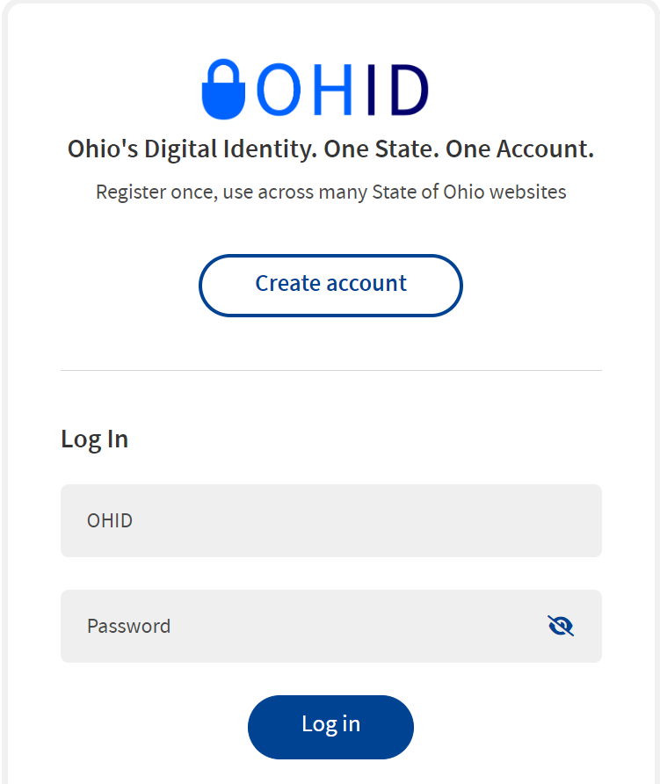
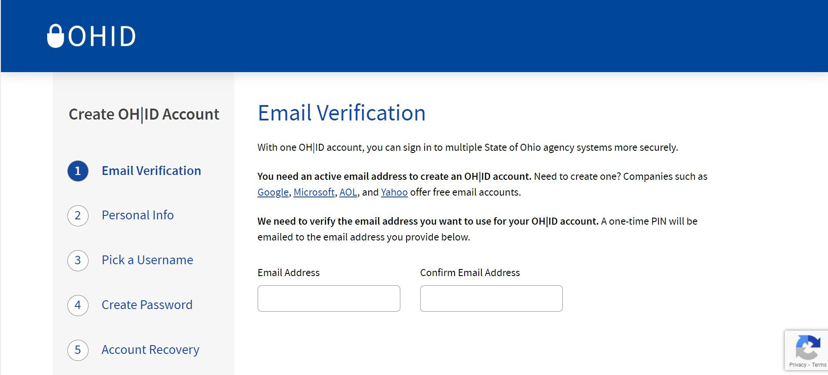
OHID ACCOUNT CREATION (1 of 5)
1
Begin at the OHID login page https://ohid.ohio.gov/.
From the login page, press the “Create Account” button.
2
Select “Create Account” to begin the OHID account creation process.
3
Enter an active email address to continue creating an account.
2
3

Slide 5

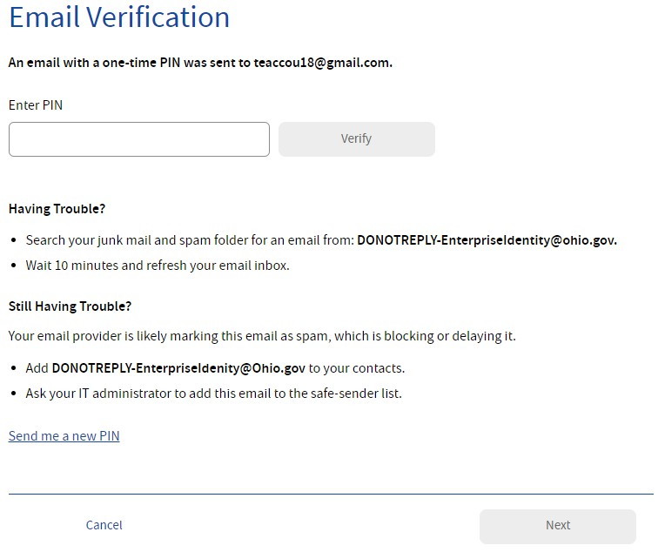

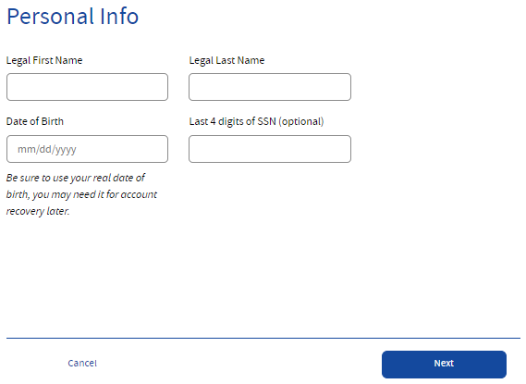
OHID ACCOUNT CREATION (2 of 5)
4
After entering an email address, a PIN will be sent to that email address.
Enter the PIN provided on the email verification screen and select “Verify.”
Note: If you do not receive the PIN immediately, request a new PIN using the “Send a new PIN” link.
4
5
Enter a Legal First Name, Last Name, and Date of Birth in MM/DD/YYYY format to continue.
Note: Last 4 of Social Security number is an optional field.
5

Slide 6

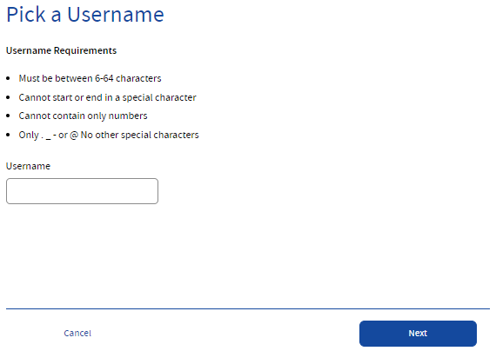

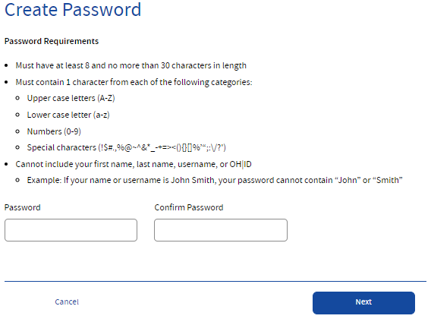
OHID ACCOUNT CREATION (3 of 5)
6
Create a username for the OHID account.
Note: The username must be between 6-64 characters, cannot start or end with a special character, cannot contain only numbers, and may only contain . _ - @ as special characters.
6
7
Create and confirm a password for the OHID account.
Note: Passwords must be between 8-30 characters; must contain at least one upper case letter, lower case letter, number, and special character; and cannot contain the user’s first name, last name, username, or OHID.
7

Slide 7

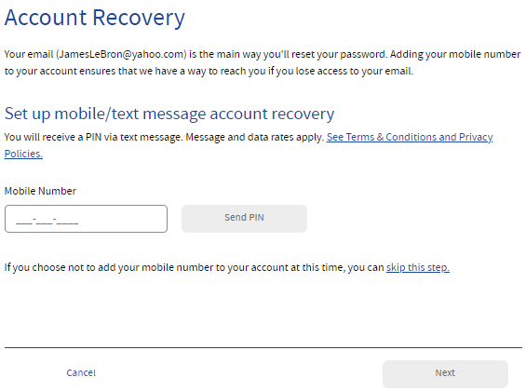

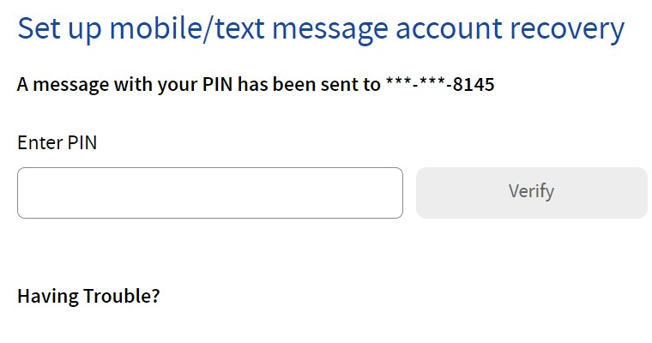

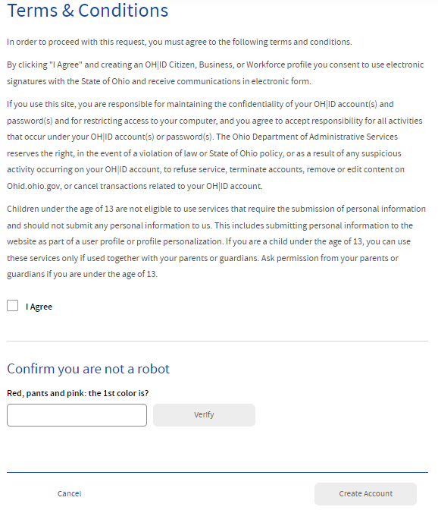
OHID ACCOUNT CREATION (4 of 5)
8
Enter an active mobile phone number to enable optional account recovery.
8a
Select “Send PIN” to send a PIN to the mobile phone number.
Enter the PIN to verify your mobile phone.
8b
9
Check the “I Agree” box under the "Terms & Conditions" section and answer the “Confirm you are not a robot” question.
9
Next, select “Verify,” and then “Create Account.”

Slide 8

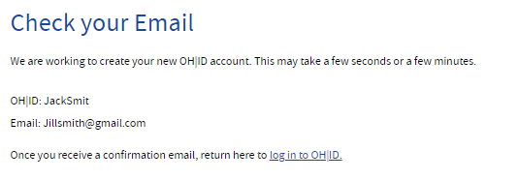


OHID ACCOUNT CREATION (5 of 5)
10
Verify receipt of the account creation email, then navigate back to the “Check your Email” page and select the “log in to OHID” hyperlink.
Note: Customers can also go directly to ohid.ohio.gov and log in on the OHID login page.
10
11 Log in to OHID using the new OHID username and password.
11

Slide 9
OHID ACCOUNT RECOVERY

Slide 10

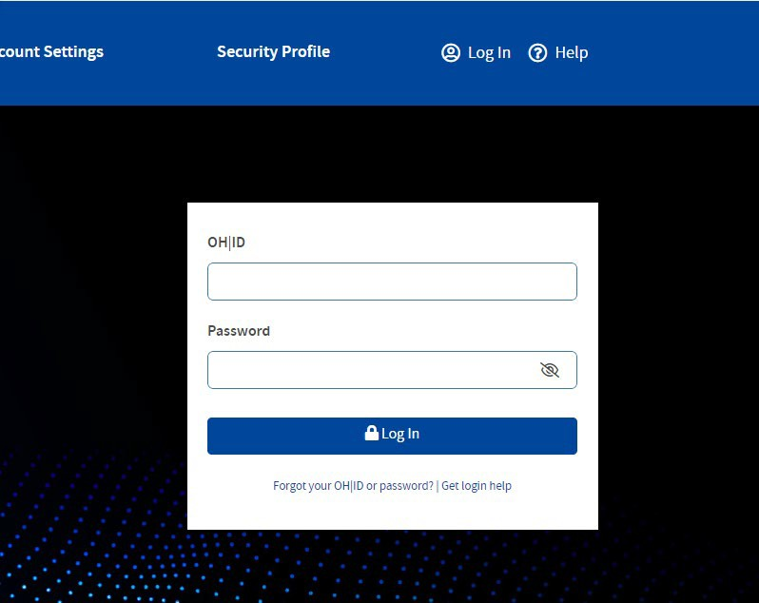

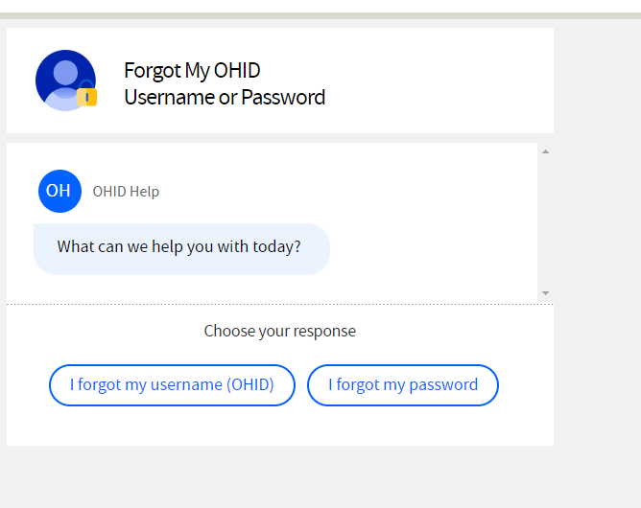
OHID USERNAME AND PASSWORD RECOVERY (1 of 2)
1 If customers with an existing OHID need support with their username or password, they should open the OHID account recovery chatbot by selecting “Forgot your OHID or password” under the “Log In” button
1
2
After selecting “Forgot your OHID or password” a chatbot will open to help support customers with username recovery, password resets or new account creation.
2

Slide 11

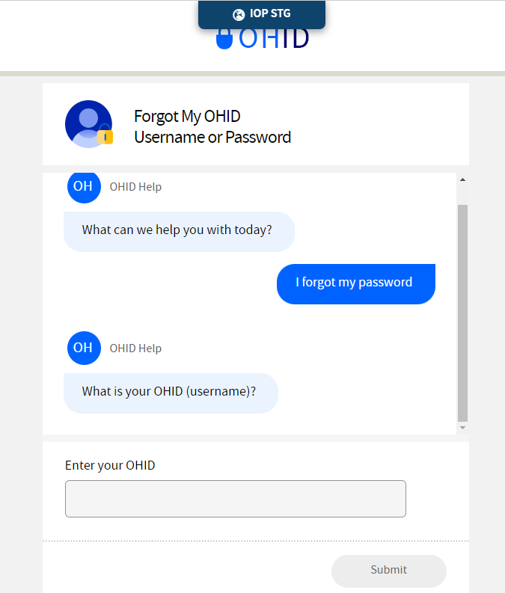
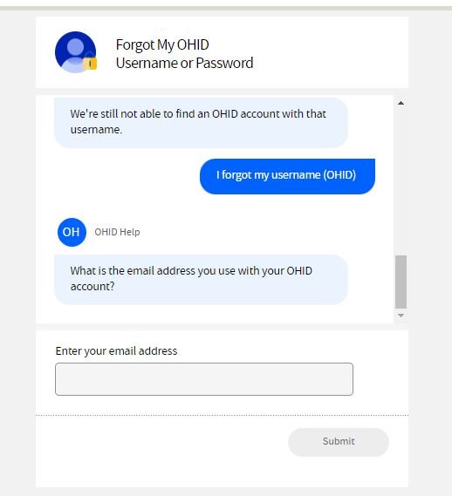

OHID USERNAME AND PASSWORD RECOVERY (2 of 2)
Password Recovery
If a user forgets their password, they can communicate with the chatbot to recover their password by entering their OHID when prompted.
Username Recovery
If a user forgets their username, they can enter their email address associated with their OHID when prompted.

Slide 12
MULTI-FACTOR AUTHENTICATION
Setting up multi-factor authentication (MFA) enrollment

Slide 13
WHAT IS MULTI-FACTOR AUTHENTICATION?
Multi-factor Authentication (MFA) is a security procedure that allows Ohioans to verify that they are who they claim to be. This is done by confirming additional identifying information from a secondary source.
Key Terms and Definitions
Single Sign-On
Single Sign On (SSO) refers to a sign on process which allows users to access multiple state agency resources through a single set of log in credentials (OHID and Password).
Multi-factor Authentication
Multi-factor Authentication (MFA) is a second form of verification that the user logging in is who they claim they are. There will be multiple options available, including SMS text, phone call, email, and mobile app verification.

Slide 14

MFA REGISTRATION OPTIONS OVERVIEW
There are four options available for MFA Registration. Please register for at least two MFA options.
Email
A PIN will be sent to the user’s email associated with the OHID account.
SMS Text Message
An SMS text with a PIN will be sent to the user’s phone number.
Phone Call
An automated call will be made to the user’s phone number.
IBM Verify App
User is given the option to authenticate through PIN displayed in app and an in-app push button option.
Text, email, or phone calls are recommended.
14

Slide 15
MFA REGISTRATION OPTIONS (1 of 2)
There are four options available for MFA Registration. Please register for at least two MFA options.
It is recommended to choose a combinationof phone-based and email options just in case you do not have multiple cell phones or lose your phone.
SMS Text Message
Email
A PIN will be sent to the user’s email associated with the OHID account.
An SMS text with a PIN will be sent to the user’s phone number.
Level of Difficulty:
LOW
LOW
The SMS verification option sends the user a one-time access code to their phone via text message.
Users must select an active mobile phone number.
For text message and phone call verification to be counted as separate methods, users cannot use the same phone number for both options.
The Email verification option sends the user an email containing a one-time verification code to the email address they used to set up MFA.
Users should use an active email account they have access to.

Slide 16

MFA REGISTRATION OPTIONS (2 of 2)
There are four options available for MFA Registration. Please register for at least two MFA options.
It is recommended to choose a combinationof phone-based and email options just in case you do not have multiple cell phones or lose your phone.
Phone Call
IBM Verify App
An automated call will be made to the user’s phone number.
User is given the option to authenticate through PIN displayed in app and an in-app push button option.
Level of Difficulty:
LOW
MEDIUM
The Phone Call verification option places an automated phone call to the user’s phone number.
Users must select an active phone number.
For text message and phone call verification to be counted as separate methods, users cannot use the same phone number for both options.
The IBM Verify verification app will send a push notification when selected as the MFA option.
The IBM Verify app is free in both the Google Play and Apple App stores.

Slide 17
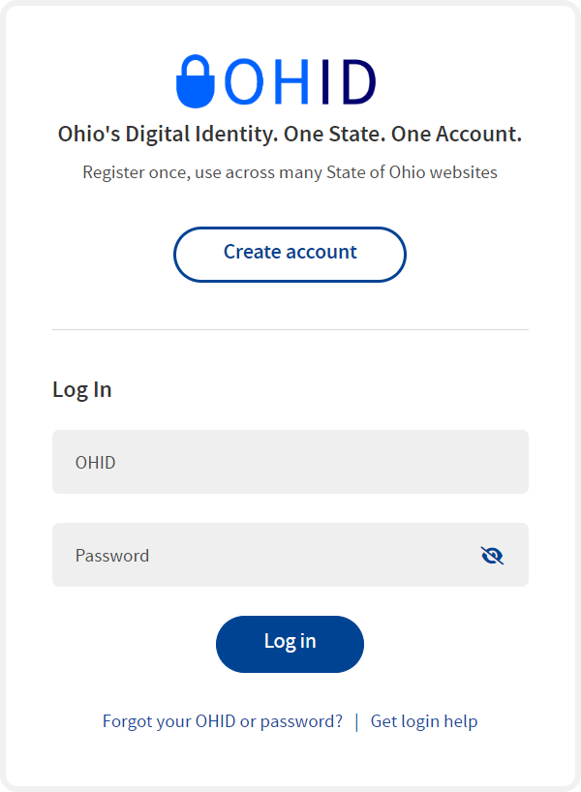
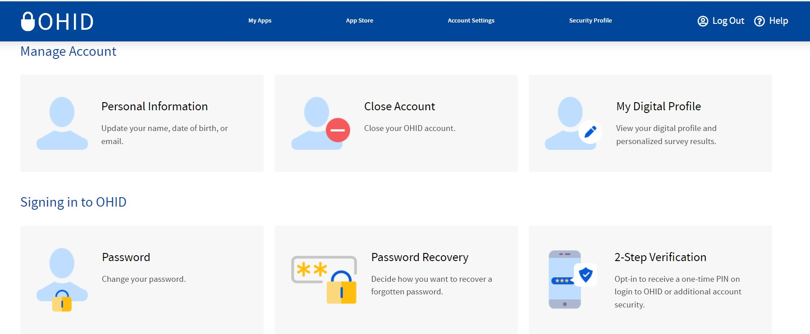
2-STEP VERIFICATION ENROLLMENT (1 of 3)
1
1
Visit OHID.ohio.gov and log in using your OHID and password.
Note: You can only enroll in 2-Step Verification options on the OHID website.
2
Select “Account Settings” then select “2-Step Verification.”
2

Slide 18
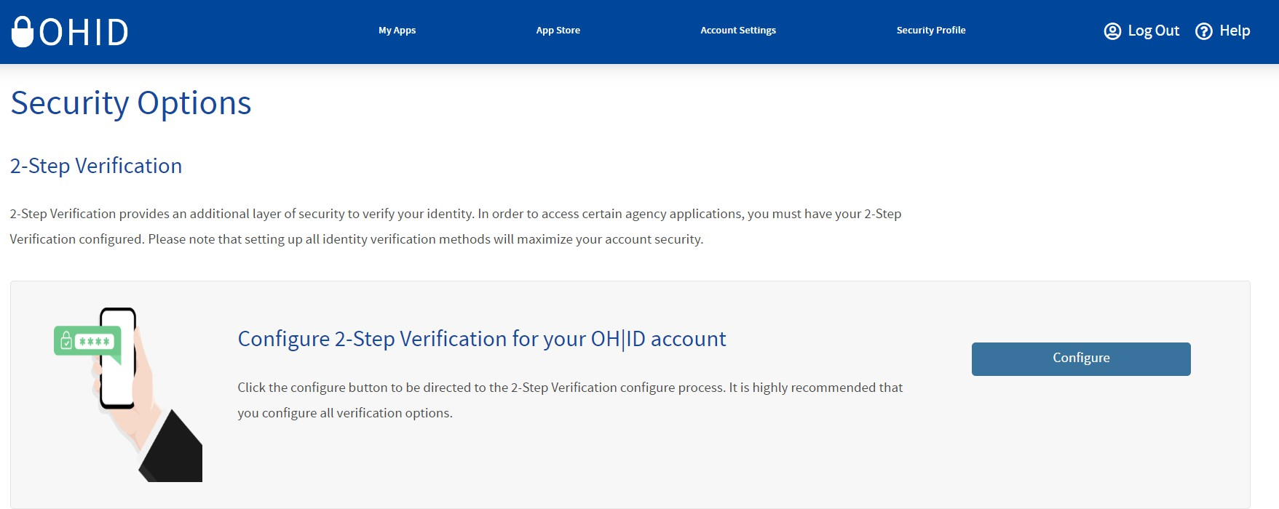
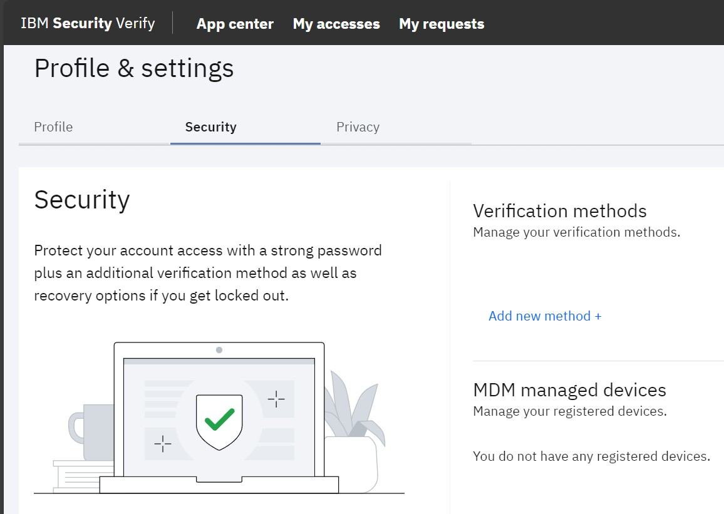
2-STEP VERIFICATION ENROLLMENT (2 of 3)
3
Select “Configure.”
3
4
Select “Add new method +.”
4

Slide 19
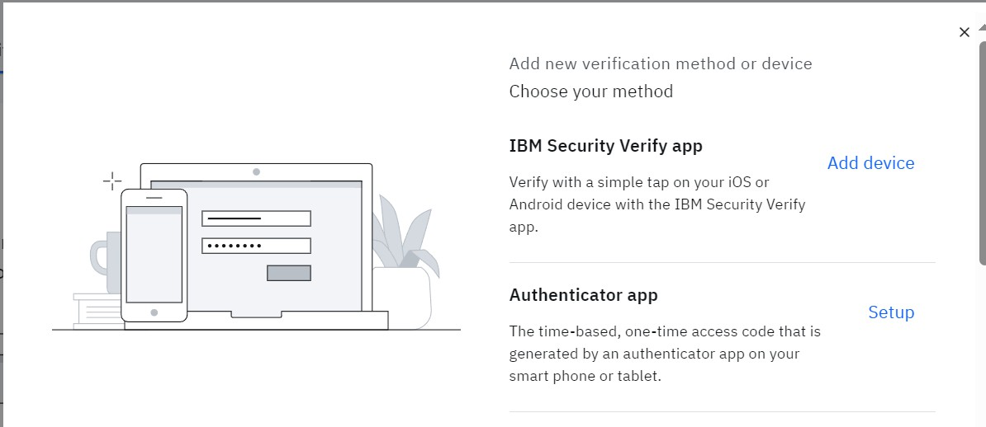
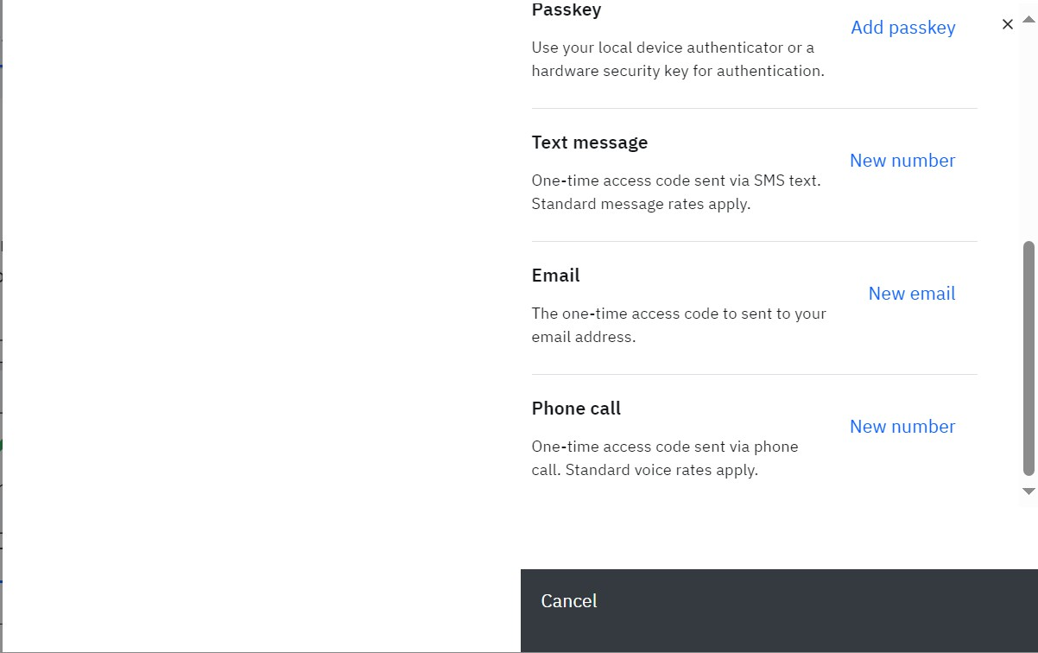
2-STEP VERIFICATION ENROLLMENT (3 of 3)
5
You will see all verification methods appear on the screen for selection.
Note: You will need to set up 2 methods of verification. It is recommended that you select one phone-based option (phone call or text) and one email option.
5

Slide 20
TEXT MESSAGE
2-Step Verification Enrollment Method

Slide 21
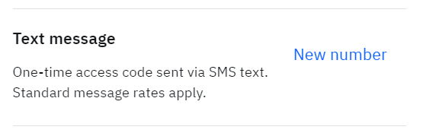
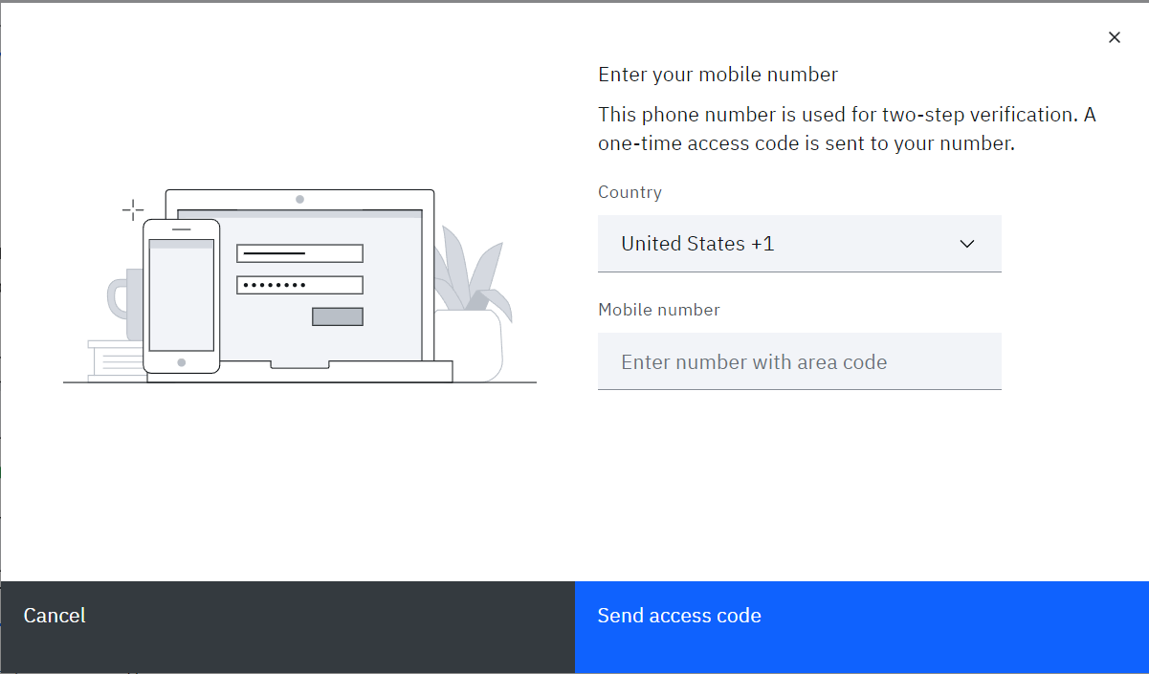
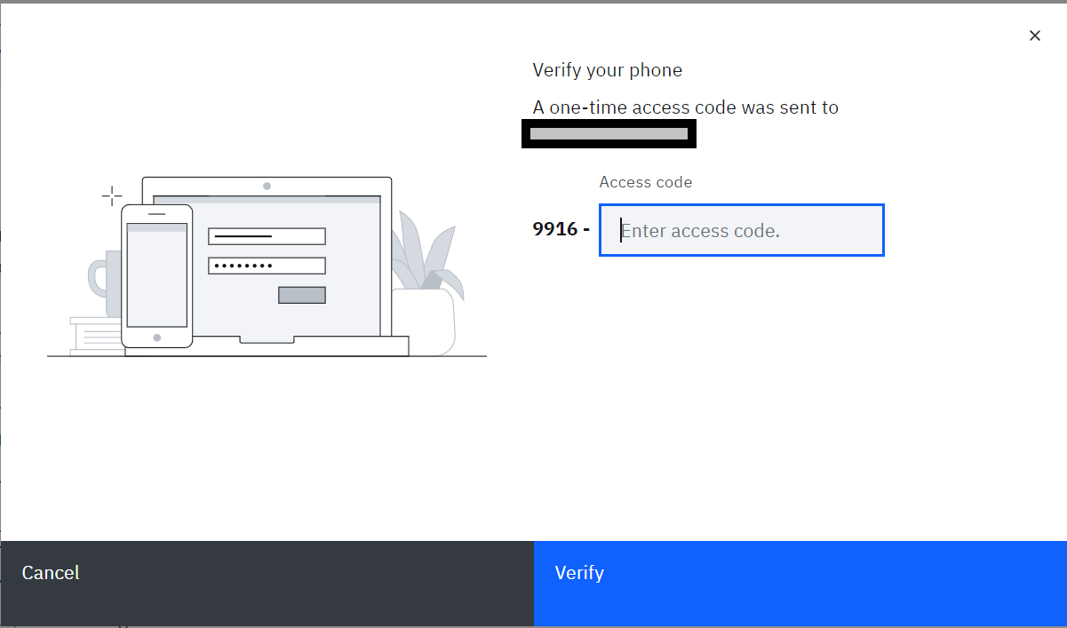
2-STEP VERIFICATION ENROLLMENT - TEXT MESSAGE (1 of 2)
1
Select “New number” highlighted in blue.
1
2
Enter your mobile number and select “Send access code.”
Note: If the same phone number is entered for more than one 2-Step Verification options, you will be prompted to "Enroll another method.”
26
2
3
Enter the access code that appears in the text message sent to you and select “Verify.”
3
1-000-000-0000

Slide 22
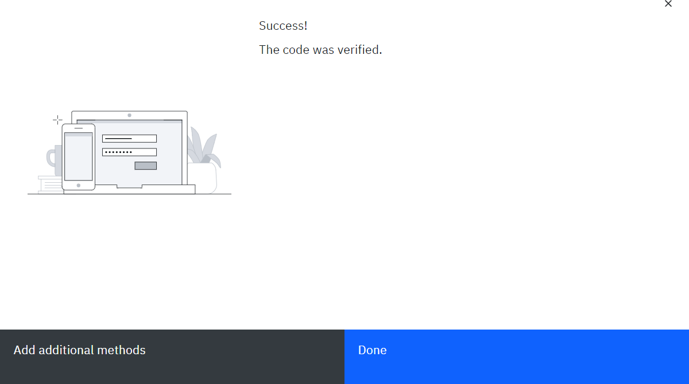
2-STEP VERIFICATION ENROLLMENT - TEXT MESSAGE (2 of 2)
4 Once you enter and verify, you will see this page showing that you have successfully added the text message method of verification. You may select “Add additional method” if you have not yet enrolled in two methods. Select “Done” if you have already set up another method.
4

Slide 23
EMAIL
2-Step Verification Enrollment Method

Slide 24
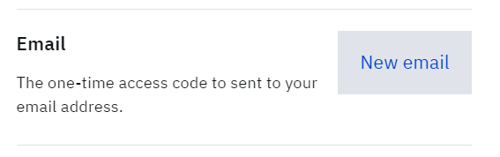
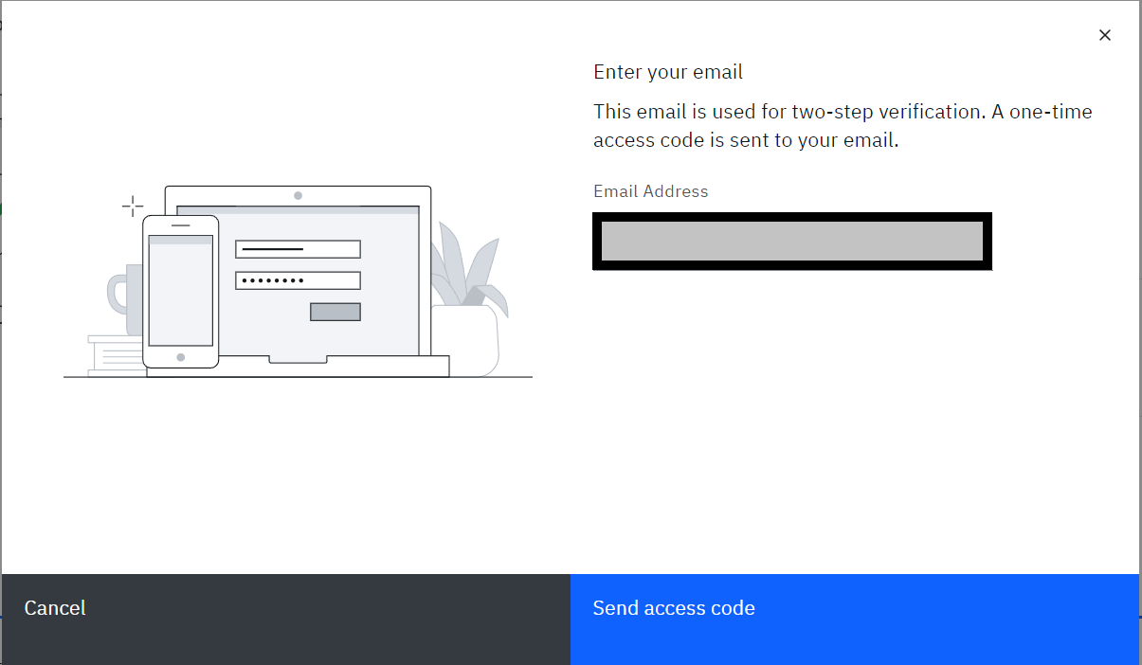

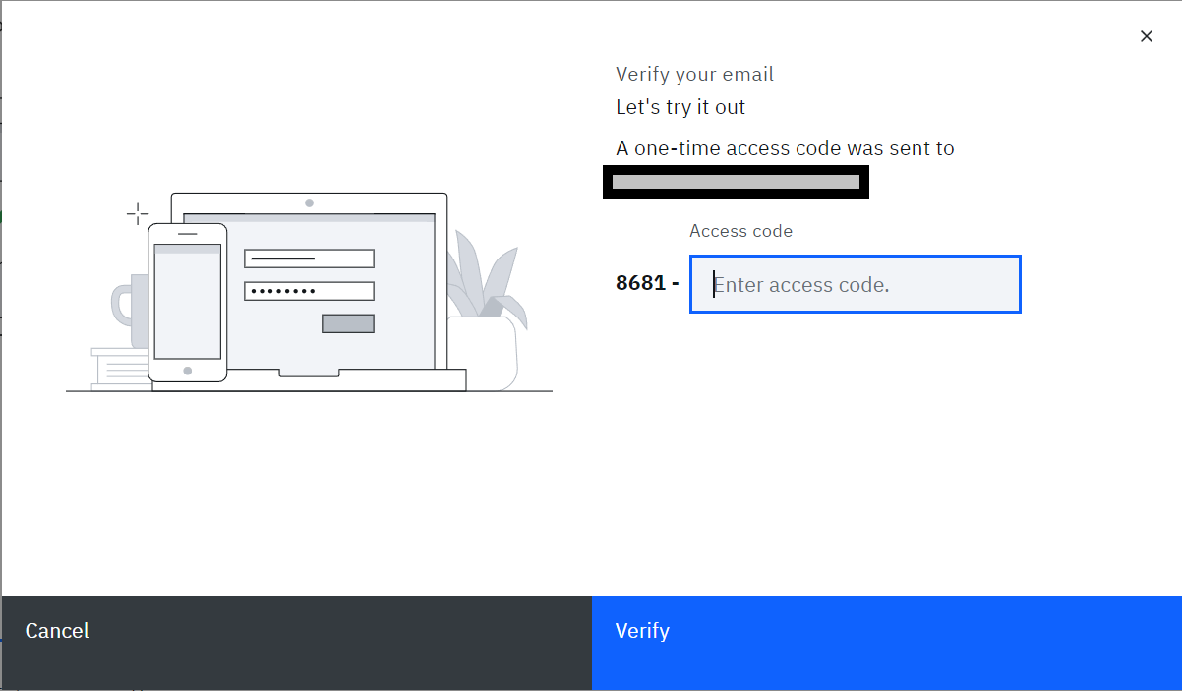
2-STEP VERIFICATION ENROLLMENT – EMAIL (1 of 2)
1
Select “New email” highlighted in blue.
1
2 Enter your email address and select “Send access code”
2
3
Enter the access code that appears in the email that was sent to you and select “Verify.”
3
Test@Gmail.com

Slide 25
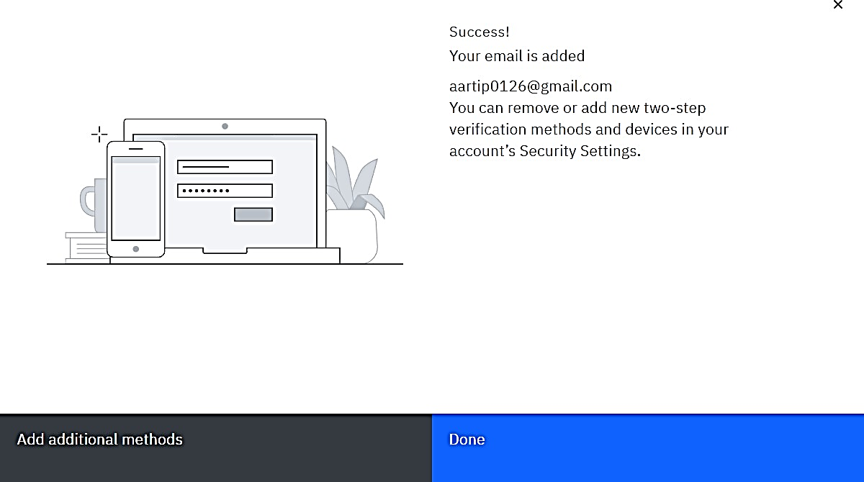
2-STEP VERIFICATION ENROLLMENT – EMAIL (2 of 2)
4 Once you enter and verify, you will see this page showing that you have successfully added the email method of verification. You may select “Add additional method” if you have not yet enrolled in two methods. Select “Done” if you have already set up another method.
4
Test@Gmail.com

Slide 26
PHONE CALL
2-Step Verification Enrollment Method

Slide 27
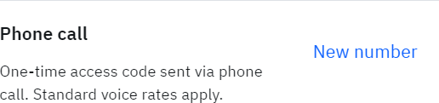
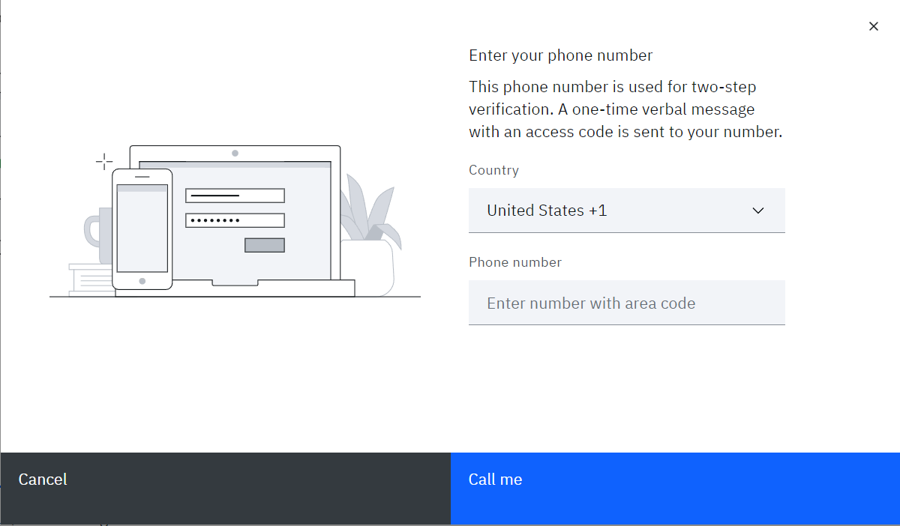
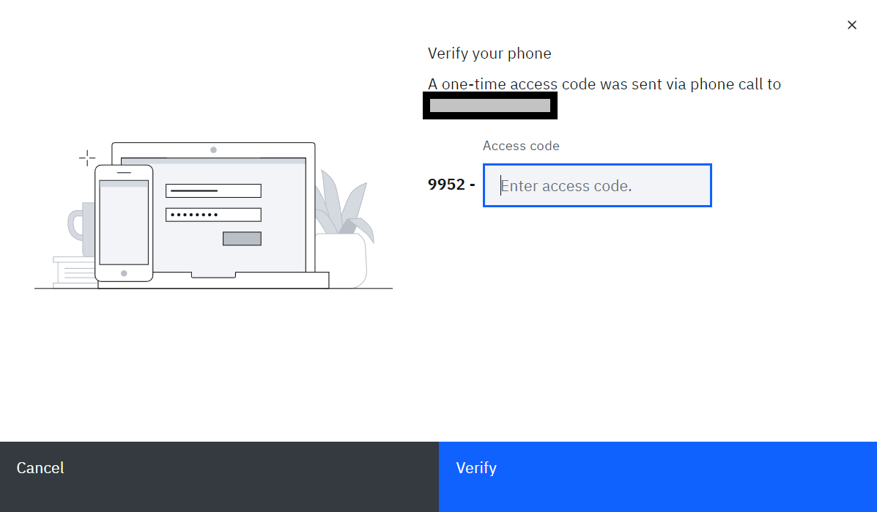
2-STEP VERIFICATION ENROLLMENT - PHONE CALL (1 of 2)
1
Select “New number” highlighted in blue.
1
2
Enter your phone number and select “Call me.”
Note: If the same phone number is entered for more than one 2-Step Verification options, you will be prompted to "Enroll another method.”
2
3
Pick up the phone call you receive and enter the access code that the automated messenger states to you and select “Verify.”
3
1-000-000-0000

Slide 28
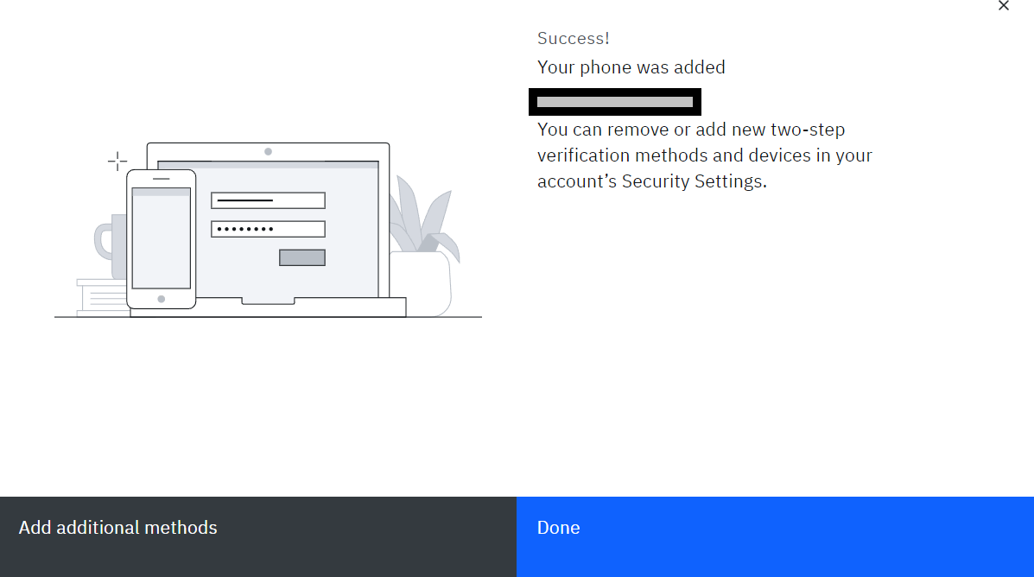
2-STEP VERIFICATION ENROLLMENT - PHONE CALL (2 of 2)
4
Once you enter and verify, you will see this page showing that you have successfully added the phone call method of verification. You may select “Add additional method” if you have not yet enrolled in two methods or select “Done” if you have already done so.
4
1-000-000-0000

Slide 29
IBM VERIFY
2-Step Verification Enrollment Method

Slide 30
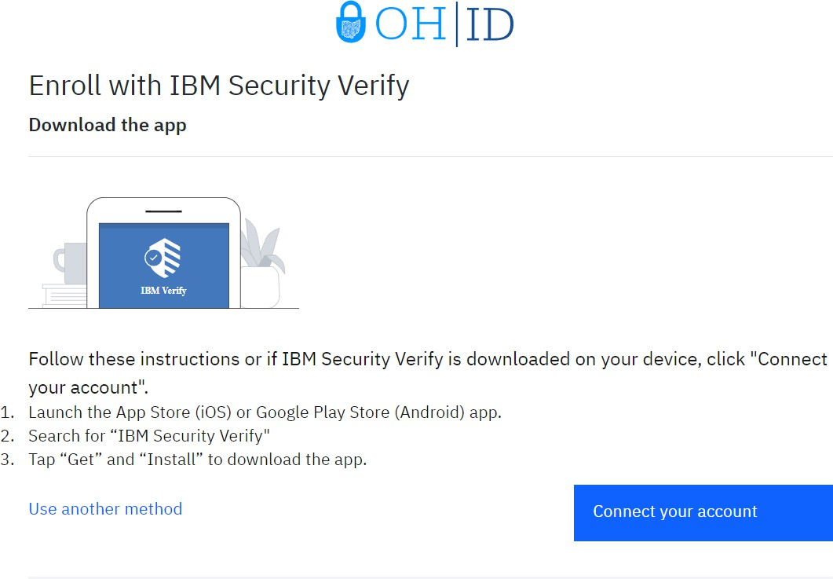
MFA ENROLLMENT: IBM VERIFY APP (1 of 7)
1
After selecting “Add Device” on the initial MFA enrollment page, you will download the IBM Verify App to your device and press “Connect Your Account.”
1

Slide 31
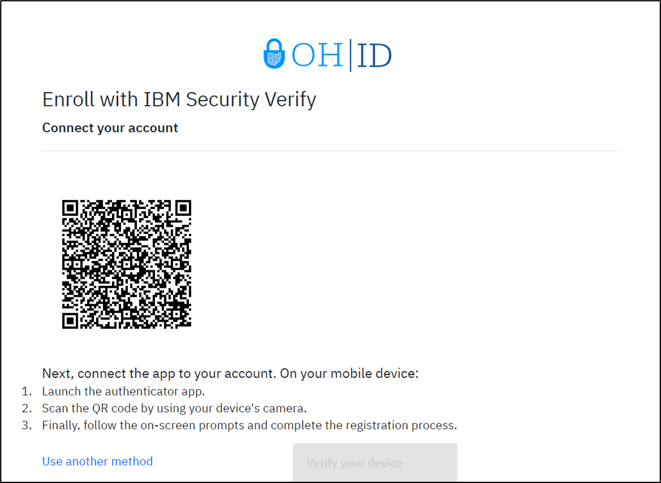
MFA ENROLLMENT: IBM VERIFY APP (2 of 7)
2 After pressing “Connect your account” you will be met with the following screen and will need to access the IBM Verify app on your device to continue with registration.
2

Slide 32
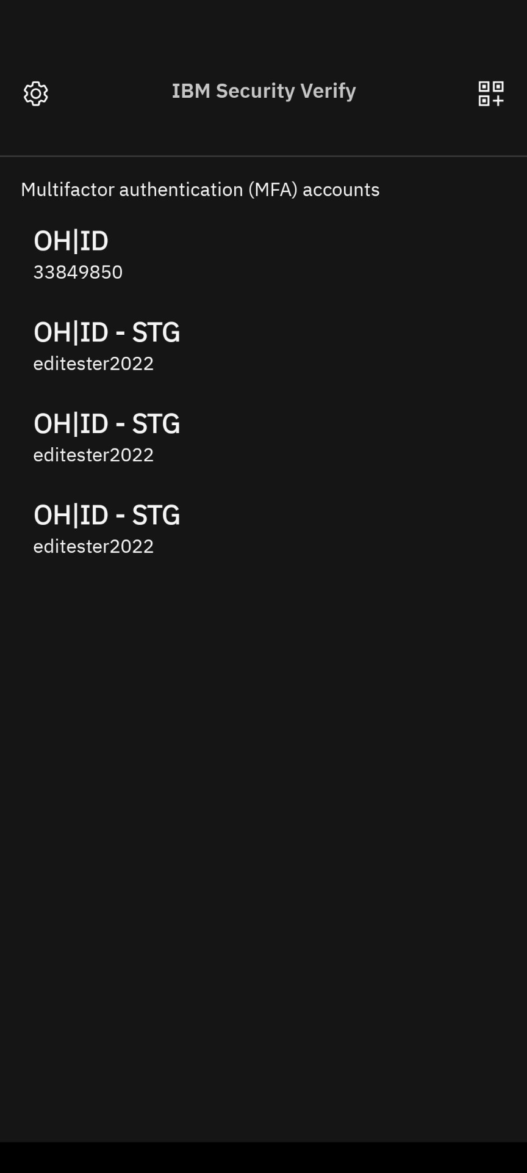
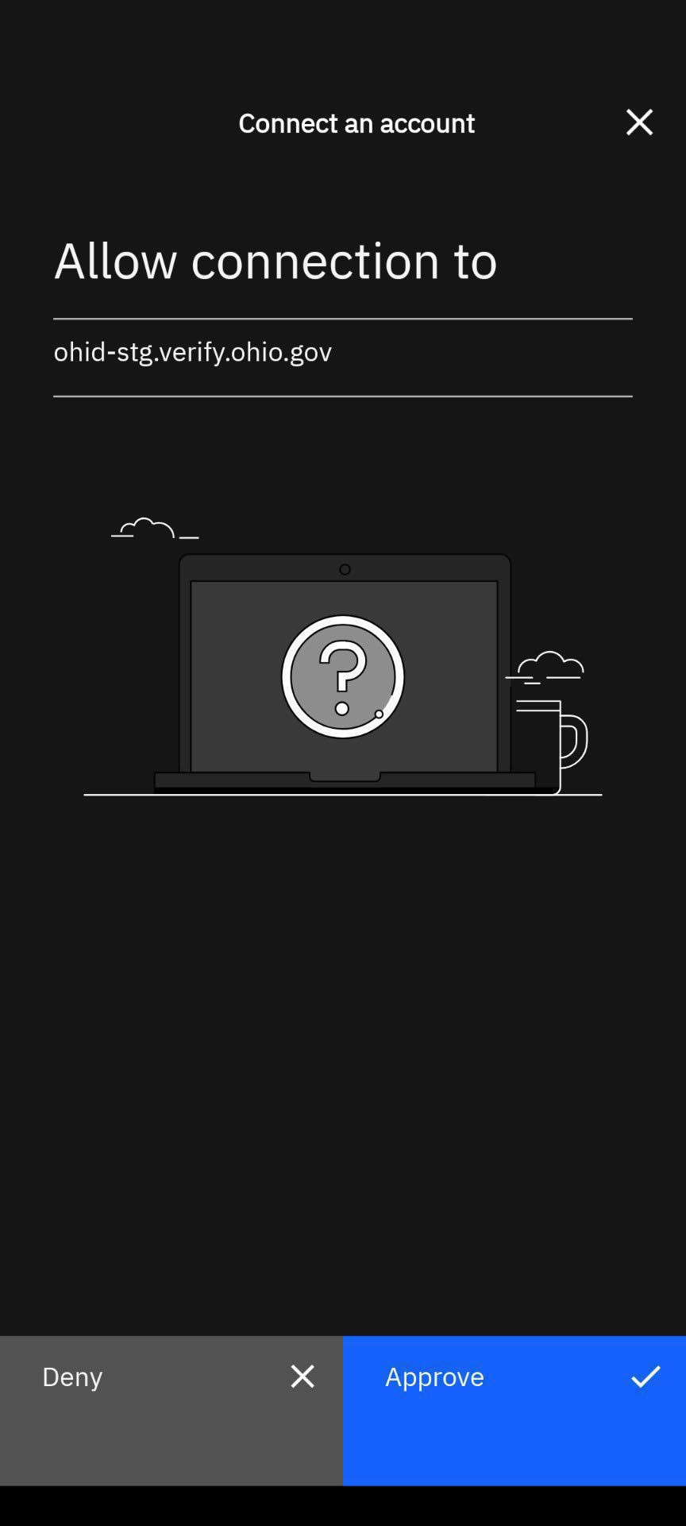

MFA ENROLLMENT: IBM VERIFY APP (3 of 7)
3
Scan the QR Code using the IBM app by opening the App’s Camera.
4
Approve the connection after scanning the QR code.
3
4

Slide 33
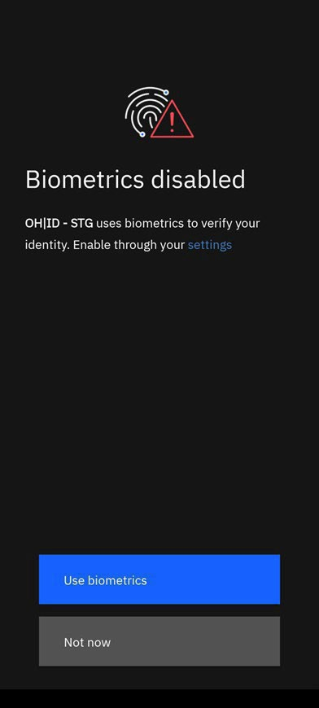

MFA ENROLLMENT: IBM VERIFY APP (4 of 7)
5
Choose Biometrics preference. This has no bearing on linking the account to MFA.
6
Your account is now linked, press “Done.”
5
6

Slide 34
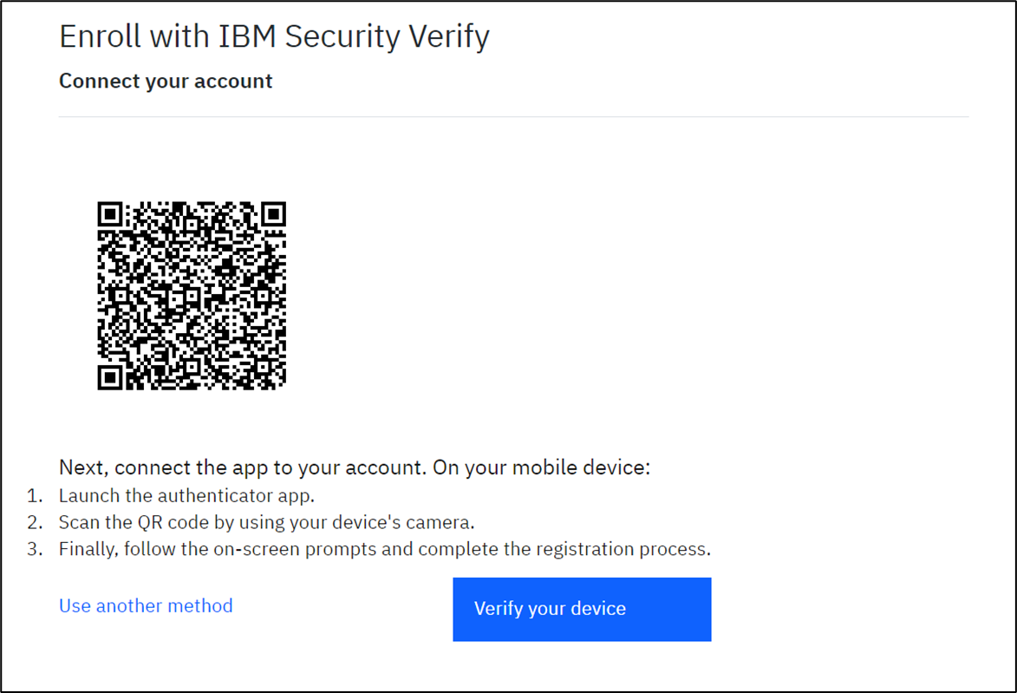
MFA ENROLLMENT: IBM VERIFY APP (5 of 7)
7
Select “Verify your device” to continue with IBM Verify Enrollment.
7

Slide 35
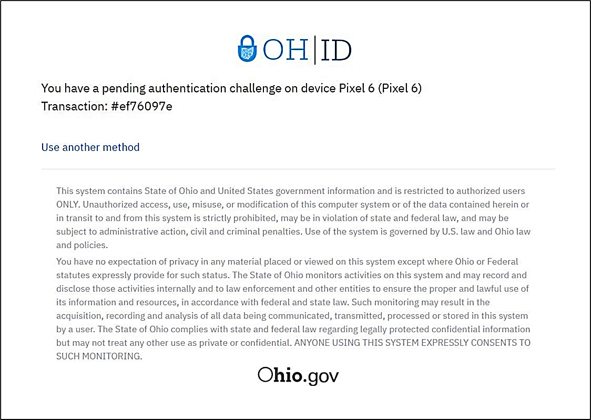
MFA ENROLLMENT: IBM VERIFY APP (6 of 7)
8
You will now receive an “authentication challenge” to the IBM Verify app. To complete this, open the app, click the challenge, and approve the connection.
Note: The IBM Verify App does not allow screenshots for this step.

Slide 36
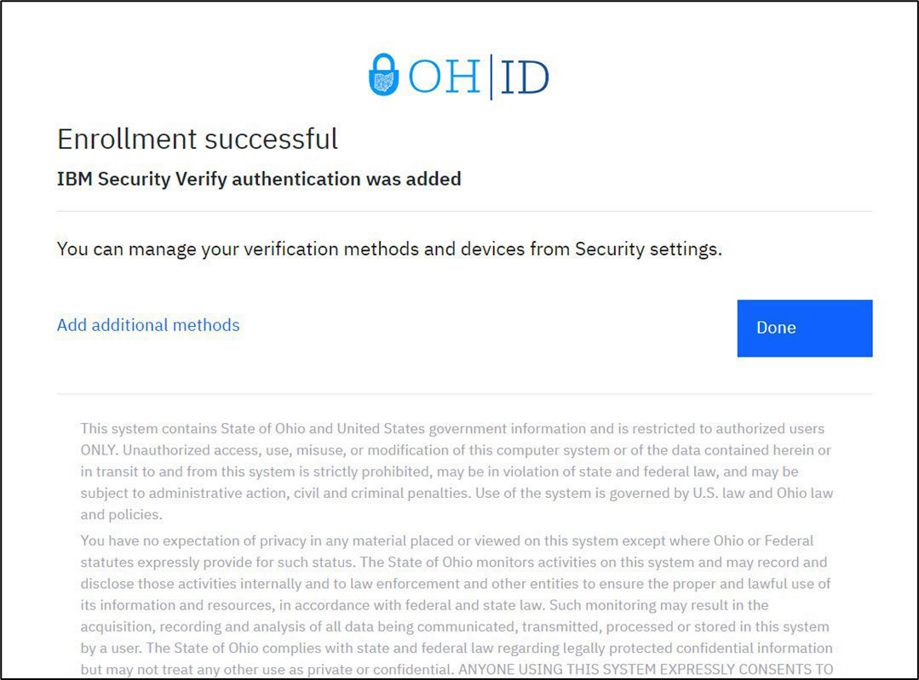
MFA ENROLLMENT: IBM VERIFY APP (7 of 7)
9
After successfully completing the authentication challenge, you will be met with the following screen. From here you can select “Add Additional Methods” if you need another MFA option or “Done” if you are finished enrolling. Pressing “Done” will redirect you to the application.
9

Slide 37
2-STEP VERIFICATION ENROLLMENT IBM VERIFY BEST PRACTICES
Before enrolling in the IBM Verify option, please download the IBM Verify application from the Apple App Store or the Google Playstore.
The QR code provided to link your 2-Step Verification option to your device or application is for one-time use only. If you fail to connect the application the first time, you will need to return to the initial 2-Step Verification enrollment page, select “Add device," select “IBM Verify” and begin the process again.
The option for biometric login is dependent on your device capability. For example, if you have an iPhone with a “home” button (iPhone 8/8s) with TouchID activated, you can use the biometric confirmation. Any models without a “home” button and TouchID will be unable to confirm identity with biometrics. However, if you have FaceID enabled, you can select that option for biometric confirmation.
Although IBM Verify is not a “phone-based option” like SMS text and phone call, we still recommend choosing an email-based backup as your secondary 2-Step Verification option. If you do not have access to your registered phone number(s), you will not be able to complete 2-Step Verification with IBM Verify, SMS text or phone call, but will be able to complete 2-Step Verification via email.

